Slide 1
Data Science

Slide 2
TERMINAL LEARNING OBJECTIVE
Students will understand the fundamentals of data science
Given classroom environment, instructor assistance,
workstation, physical and virtual ranges, and access to
the training materials, students will be able to do what
is described in the terminal learning objective.

Slide 3
Agenda
Friday 23JUL21
LSA1: Understand data science.
LSA2: Understand the components of Data Science statistics.
LSA3: Understand Data Processing in Data Science.
LSA5: Understand Data Science Metrics and Techniques.
LSA6: Understand the concepts associated with Data Analysis.
LSA7: Understand the concepts associated with Data Visualization.

Slide 4
LSA1: Understanding Data Science Outcome: At the end of this learning step, students will be able to define data science.

Slide 5
What is data science?

Slide 6
Data Science is the study of the generalizable extraction of knowledge from data.^{[1]}
Notes:
A data scientist requires an integrated skill set spanning mathematics, machine learning, artificial intelligence, statistics, databases, and optimization, along with a deep understanding of the craft of problem formulation to engineer effective solutions.
Example, let’s say I take the test scores from one university. Does the model I create translate to every university or is it restricted to only the people I already of data for. Sometimes its useful to draw insights on past data to explain why an outcome occurred. What is more valuable is taking past data and using it to extract knowledge of what the outcomes will be for new events.

Slide 7
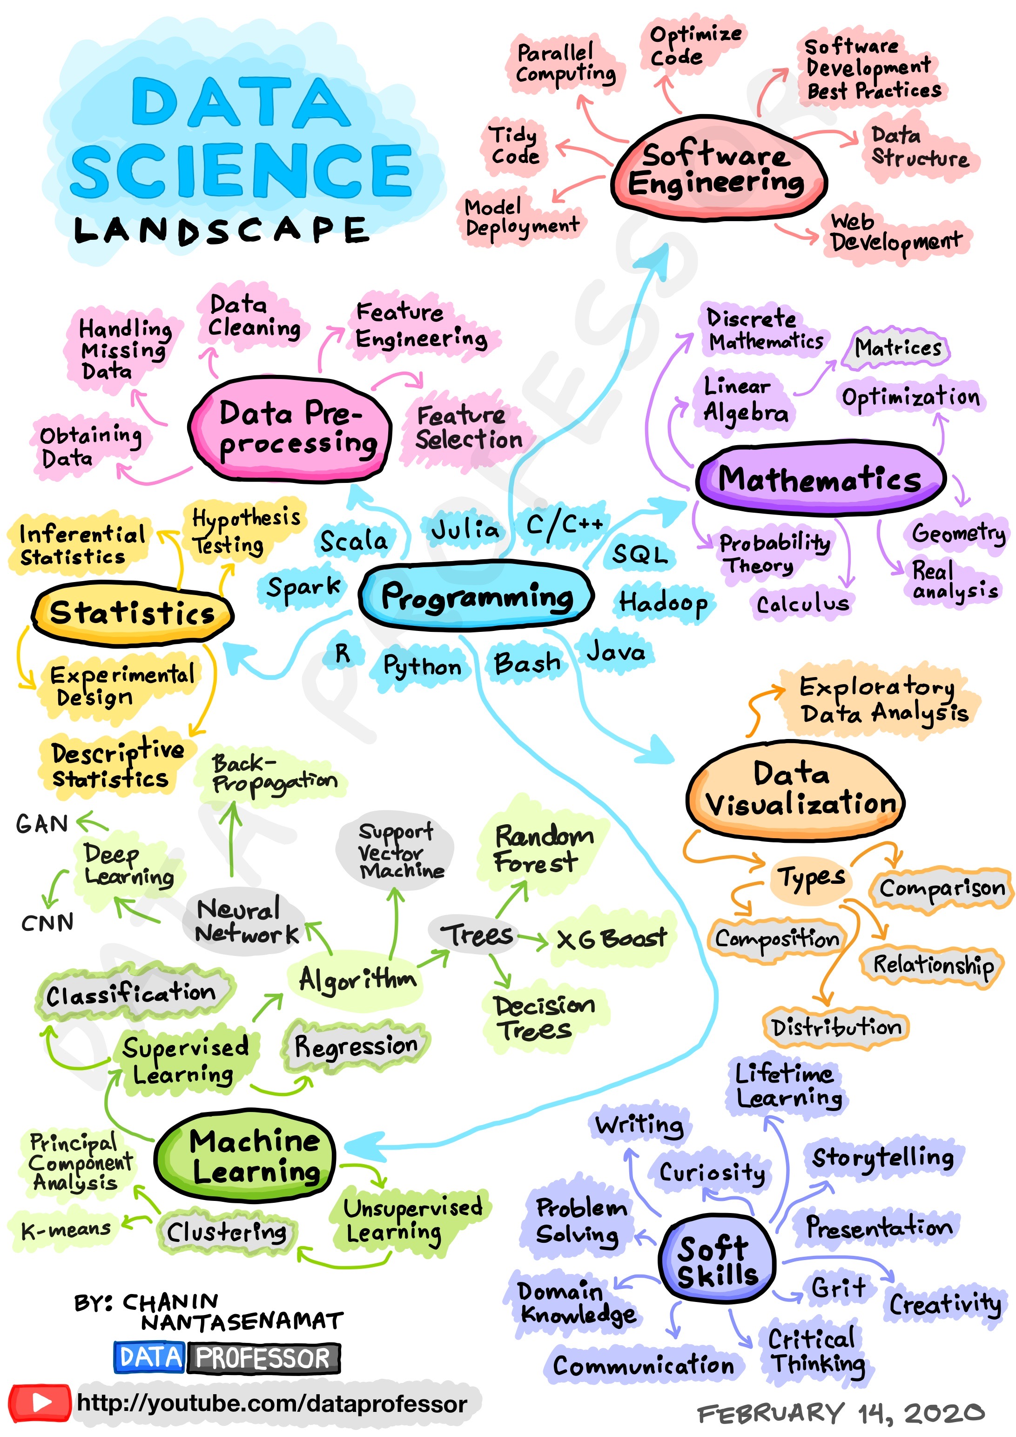

Slide 8
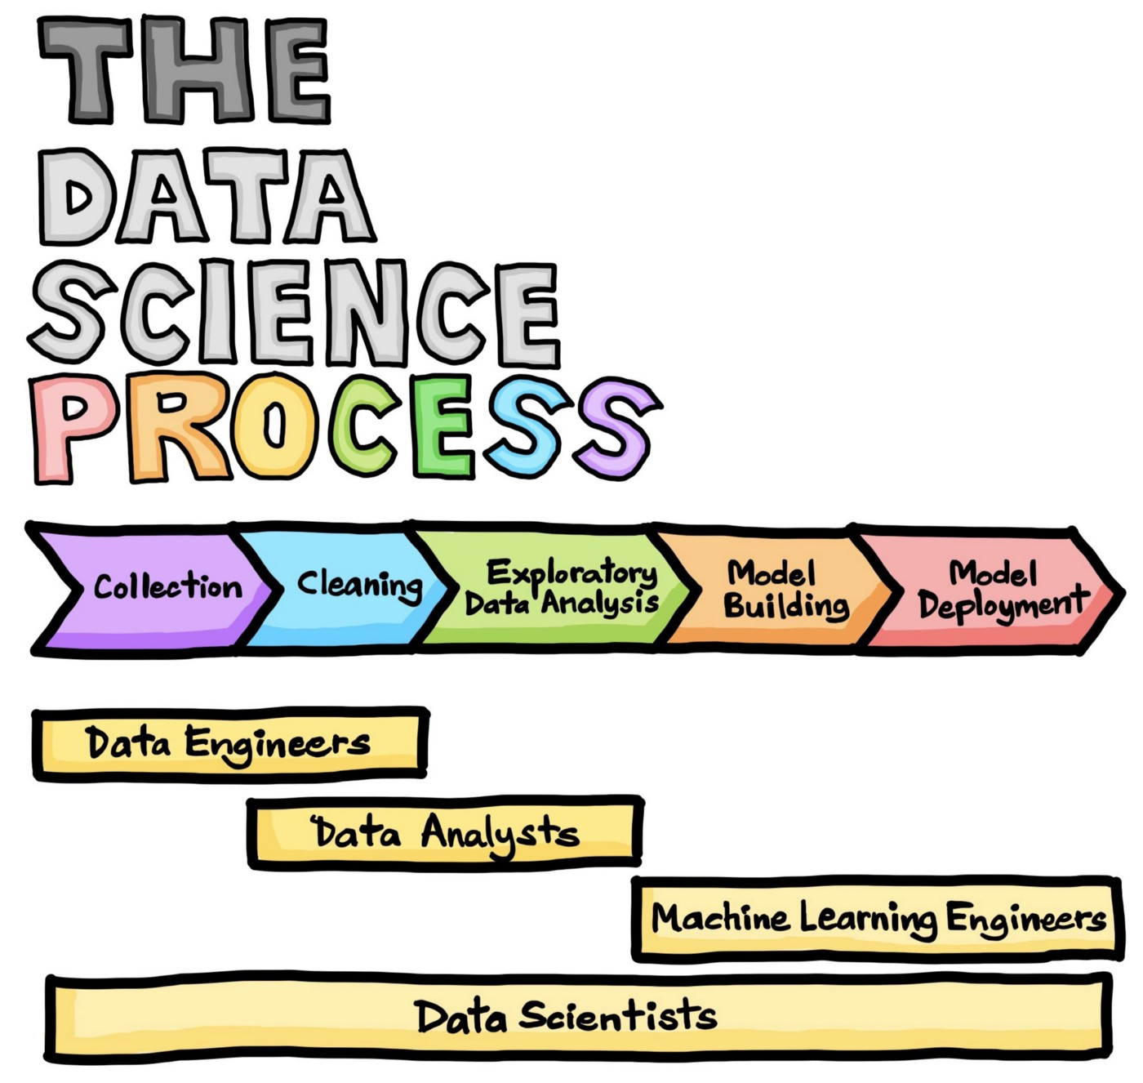
(Drawn by Chanin Nantasenamat in collaboration with Ken Jee)

Slide 9
Data Science Applications
Voice Recognition
Siri, Google Voice, Alexa
Fraud detection
Medical Image Analysis
Sports
Find undervalued players (Think Money Ball) Liverpool did this an won the 2019 Premier League championship
Determine the best positions on the field or court
E-Commerce
Automated Ad placement
Product Recommendation
Social Media
LinkedIn recommend connections
Tinder recommends Matches
Facebook presents potential connections

Slide 10



Voice Recognition
Notes:
These are three examples of voice recognition. Amazon’s Alexa, Apple’s Siri, and Microsoft’s Cortana.
They all have voice recognition features or options that can be enabled that help each device recognize the voice that is speaking. Each of us comes from a different place in the country. You can imagine that a Bostonian does not have the same accent as someone in the South. Enabling these devices to train their speech to text models based on the individual can decrease the number of times it is thinking you want to look up a mime instead of the number 9.
What value is extracted from this data?
Increase user experience leading to increase use of product leading to increased loyalty and likelihood of returning customer.

Slide 11



Video recommendation systems
Notes:
Videos are presented in way that links to what has been previously watched.
Netflix give a Score for how much they think you will like the movie.
Value add?
Recommend content that the customer is likely going to enjoy leading to subscription retention

Slide 12



E-Commerce Applications
Product Recommendations
Personalized Advertisement

Slide 13

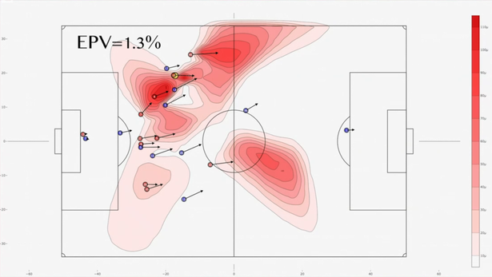
Sports – Liverpool 2019
Find undervalued players (2019 Liverpool)
Determine best strategy on the field that increases goal probability
Won 2019-2020 Premier League title
Notes:
How Math and Data Science Made Liverpool the Best Team on the Planet | by Viroshan Naicker | The Spekboom | Medium
Liverpool are using incredible data science during matches, and effects are extraordinary - Liverpool.com

Slide 14
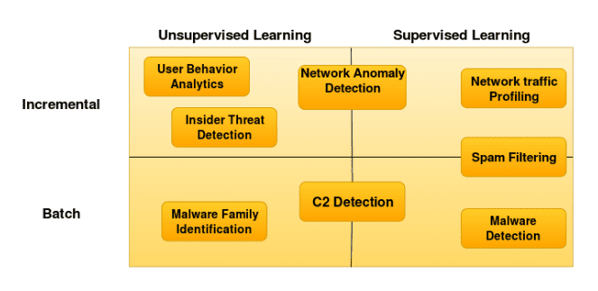
Cyber Security Applications
https://www.blueteamsacademy.com/ml-ids/

Slide 15
Conclusions
Data Science spans multiple disciplines and seeks to find actionable insights from data
Applications exist in every domain

Slide 16

Questions

Slide 17
LSA2: Understand the components of Data Science statistics. Outcome: At the end of this learning step, students will be able to identify and define the components of data science statistics.

Slide 18
Central Tendency
Used to get a simple understanding of a feature or variable
Informs how biased a dataset is.
Utilize Mean and/or Median to determine central tendency
Median is more robust to outliers

Slide 19
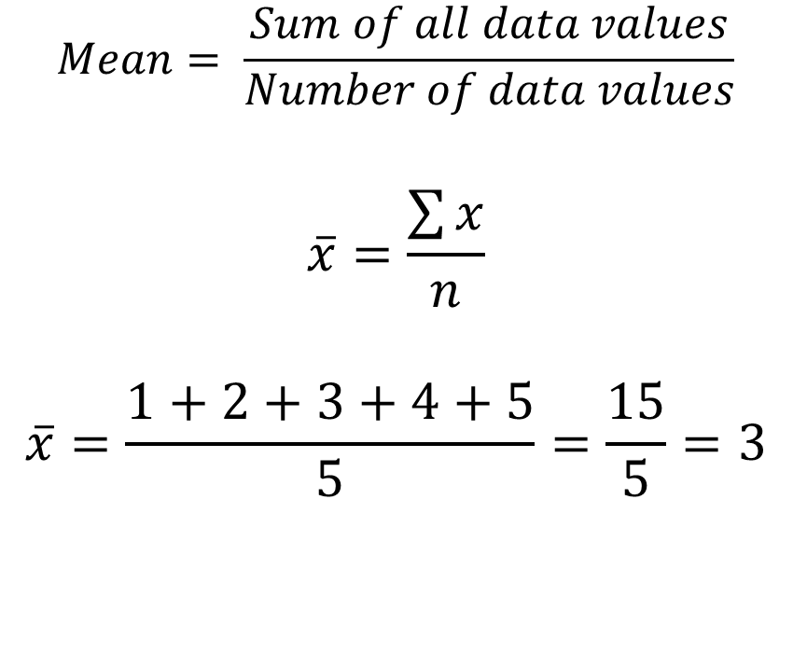
Mean – average value
$$Mean= \frac{Sum of all data values}{Number of data values}$$
$$\overline{x}=\frac{\sum{x}}{n}$$
$$\overline{x}=\frac{1+2+3+4+5}{5}=\frac{15}{5}=3$$
import statistics as stats
array = [1, 2, 3, 4, 5]
stats.mean(example_array)

Slide 20
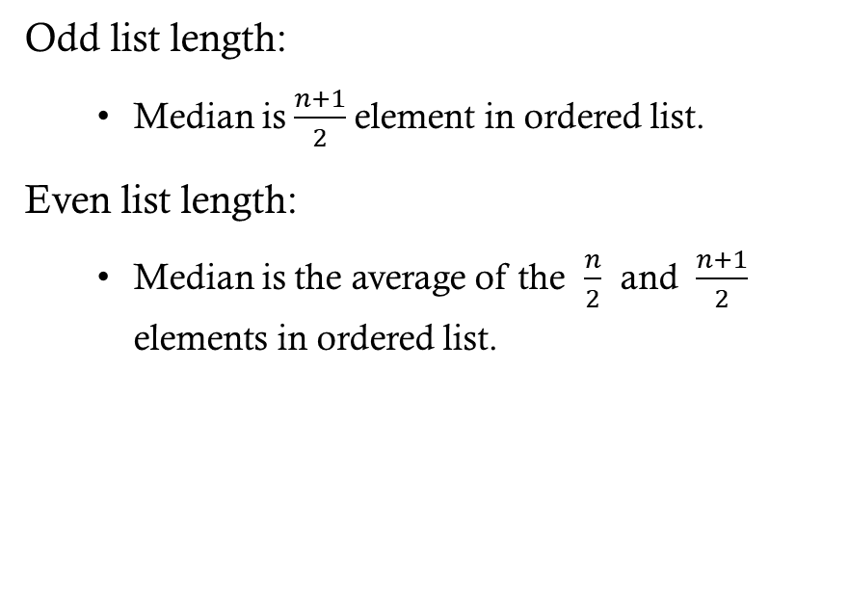
Median – middle value
Odd list length:
Median is $\frac{n+1}{2}$element in ordered list.
Even list length:
Median is the average of the $\frac{n}{2}$ and $\frac{n+1}{2}$ elements in ordered list.
import statistics as stats
array = [1, 2, 3, 3, 4, 5]
stats.median(example_array)
median = 3

Slide 21
MODE
The most frequent element.
import statistics as stats
array = [1, 2, 3, 3, 4, 5]
stats.mode(example_array)
mode = 3

Slide 22
Quartiles
Three values that split the provided data into four equal parts (25%, 50%, 75%).
Gives us insight to if a value is an outlier or not (Typically in the top/bottom 5%).
import statistics as stats
array = [1, 2, 3, 4, 9, 5]
stats.quantiles(array, n=4)=
[1.75, 3.5, 6.0]

Slide 23
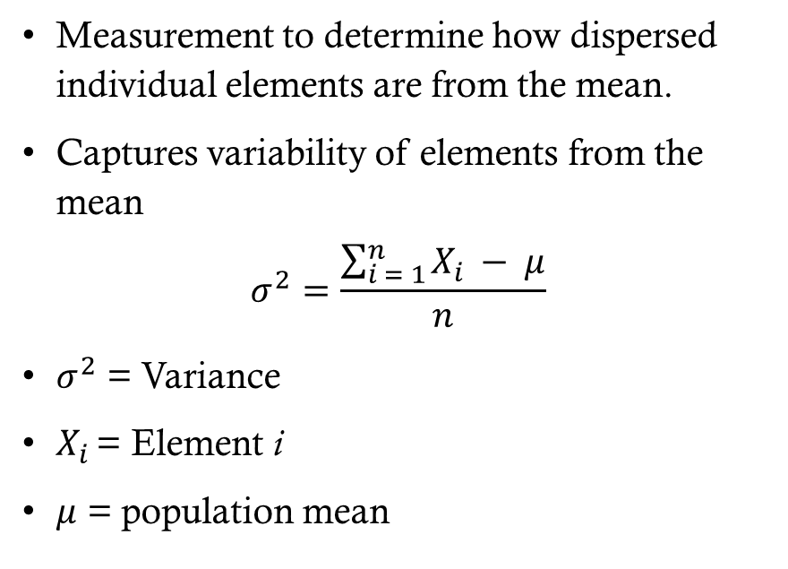
Variance
Measurement to determine how dispersed individual elements are from the mean.
Captures variability of elements from the mean
$$σ^{2}=\frac{\sum_{i = 1}^{n}{X_{i }− μ}}{n}$$
$σ^{2}$ = Variance
$X_{i }$= Element i
$μ$ = population mean
import statistics as stats
array = [1, 2, 3, 4, 9, 5]
stats.variance(array)= 8

Slide 24
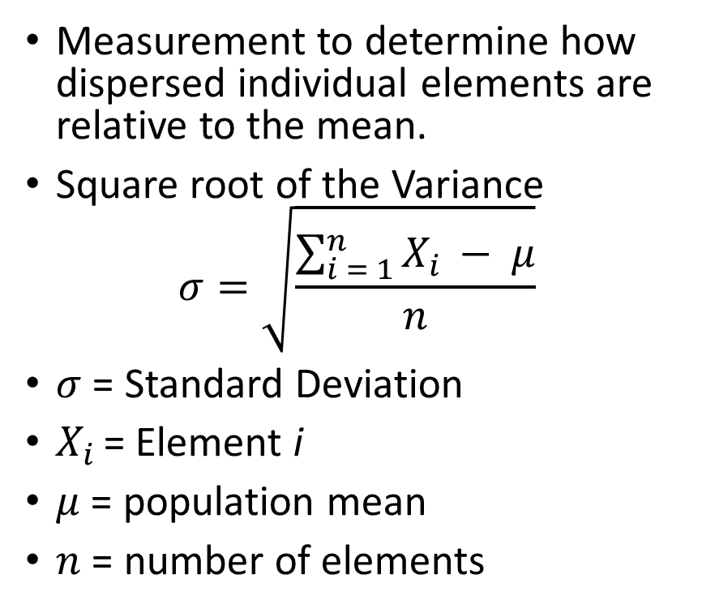
Standard Deviation
Measurement to determine how dispersed individual elements are relative to the mean.
Square root of the Variance
$$σ=\sqrt{\frac{\sum_{i = 1}^{n}{X_{i }− μ}}{n}}$$
$σ$ = Standard Deviation
$X_{i }$= Element i
$μ$ = population mean
$n$ = number of elements
import statistics as stats
array = [1, 2, 3, 4, 9, 5]
stats.stdev(array)= 2.82843

Slide 25
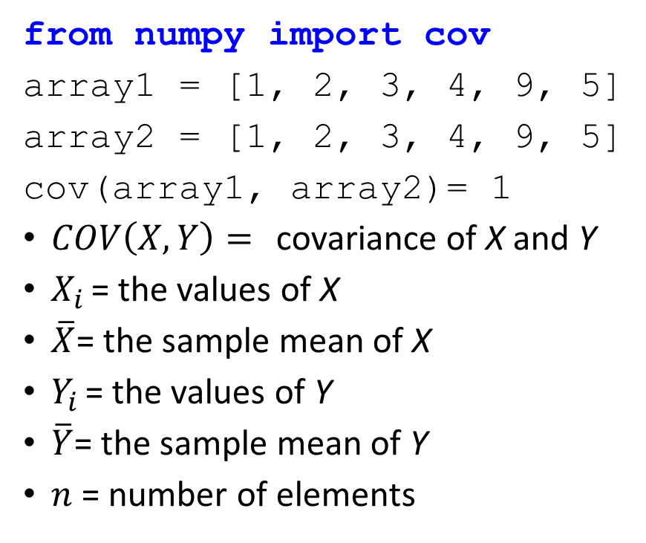
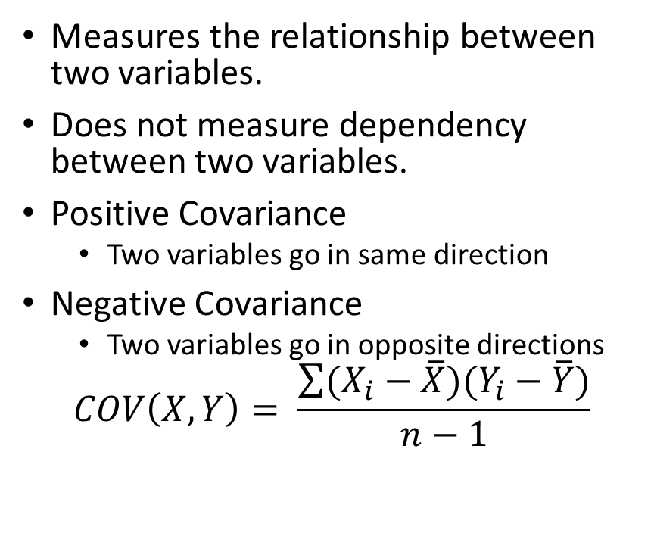
Covariance
Measures the relationship between two variables.
Does not measure dependency between two variables.
Positive Covariance
Two variables go in same direction
Negative Covariance
Two variables go in opposite directions
$$COV\left(X,Y\right)= \frac{\sum{(X_{i}−\overline{X})(Y_{i}−\overline{Y})}}{n−1}$$
from numpy import cov
array1 = [1, 2, 3, 4, 9, 5]
array2 = [1, 2, 3, 4, 9, 5]
cov(array1, array2)= 1
$COV\left(X,Y\right)=$ covariance of X and Y
$X_{i }$= the values of X
$\overline{X}$= the sample mean of X
$Y_{i }$= the values of Y
$\overline{Y}$= the sample mean of Y
$n$ = number of elements

Slide 26
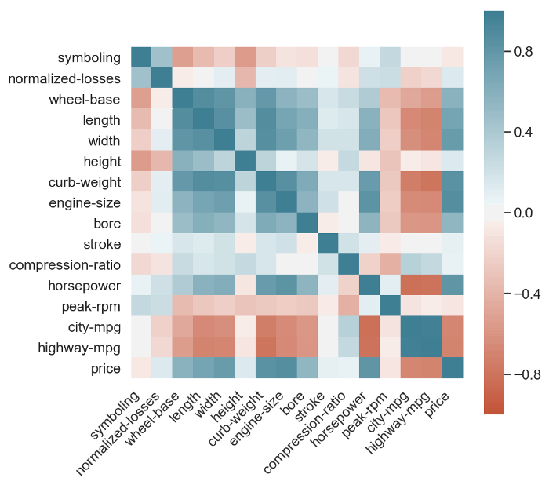
Correlation
Normalized covariance (-1.0, 1.0)
If the correlation between two variable is 1, then the change in variable one results in a proportional move in the same direction for variable 2.
Useful for Principal Component Analysis (PCA) or other dimensionality reduction techniques.
Notes:
Better Heatmaps and Correlation Matrix Plots in Python | by Drazen Zaric | Towards Data Science

Slide 27
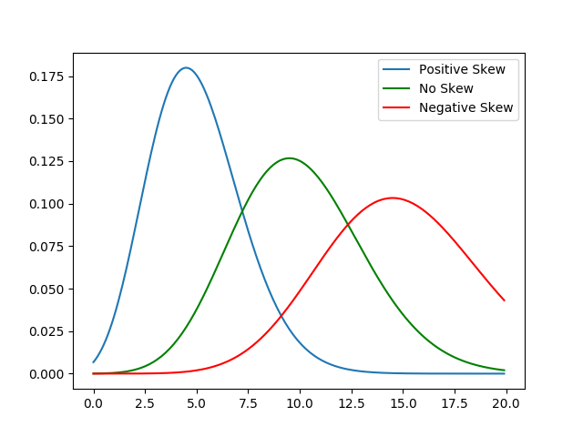
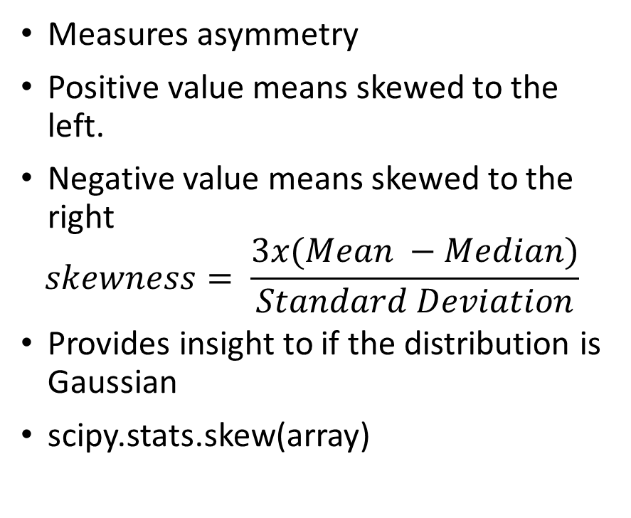
Skewness
Measures asymmetry
Positive value means skewed to the left.
Negative value means skewed to the right
$$skewness= \frac{3x(Mean −Median)}{Standard Deviation}$$
Provides insight to if the distribution is Gaussian
scipy.stats.skew(array)
Notes:
https://www.kdnuggets.com/2019/06/statistics-data-scientists-know.html

Slide 28
LSA3: Understand Data Processing in Data Science. Outcome: At the end of this learning step, students will be able to identify and define data processing techniques.

Slide 29
What is Data Preprocessing/processing?
A data science procedure in which data transforms into a clean, machine-interpretable format.

Slide 30
Encoding schemes
One hot encoding: Convert label encoding to a non-ordering relationship variable
Binarization: Convert variable into 0s and 1s based on a fixed threshold.
Discretization: Split a continuous variable into categories or groups
Equal Width, Equal Frequency, K means
Notes:
An Introduction to Discretization Techniques for Data Scientists | by Rohan Gupta | Towards Data Science

Slide 31
Normalization / Rescale
Normalization gives equal weight/importance to each variable
(Rescaling) Min-Max normalization
Mean normalization
Z-score normalization

Slide 32
Processing values
Missing Values
Remove entries with missing values
Impute values for those missing
Duplicate Values
Remove Duplicates
Inconsistent Values
Create consistent format (Date, Address, Phone number, etc.)
Outliers
Remove

Slide 33
Why do we need to Process Data?
Missing, Duplicate, Inconsistent values
Outliers
Feature Enrichment
Feature Encoding
Dimensionality Reduction
Imbalanced data

Slide 34
One Hot Encoding
Car Maker | Categorical Value | Price
Passat | 1 | 12000
Civic | 2 | 10000
Accord | 3 | 14000
Accord | 3 | 15000
Passat | Civic | Accord | Price
1 | 0 | 0 | 1200
0 | 1 | 0 | 10000
0 | 0 | 1 | 14000
0 | 0 | 1 | 15000
Label Encoding
One-hot Encoding

Slide 35
Binarization
Passat | Civic | Accord | Price
1 | 0 | 0 | 1200
0 | 1 | 0 | 1000
0 | 0 | 1 | 14000
0 | 0 | 1 | 15000
Passat | Civic | Accord | Price
1 | 0 | 0 | 0
0 | 1 | 0 | 0
0 | 0 | 1 | 1
0 | 0 | 1 | 1

Slide 36
Discretization
Transforming continuous data into discrete data (categories or bins)
Height is a continuous variable that can be transformed into short, average, tall bins
Short (less than 60 in)
Average ( between 60-71 inches)
Tall (greater than 71 inches)
Notes:
https://www.kaggle.com/mustafaali96/weight-height

Slide 37
Why Transformations?
Utilized to make your data work better for you
Most raw data is skewed, but some models ( linear and logistic regression) follow normal distributions.
Map a skewed distribution to a normal distribution through a transform
Notes:
Catalog of Variable Transformat
Data Transformation. Understanding why the “Unsexy”… | by Goutham Dommaraju | Towards Data Scienceions To Make Your Model Work Better | by Moto DEI | Towards Data Science

Slide 38
Log Transform
Attempt to get distribution close to a normal distribution
Not applied to features with negative values
Applied for skewed-right data.
Scale changes to multiplicative scale (linearly distributed data)
Notes:
Catalog of Variable Transformat
Data Transformation. Understanding why the “Unsexy”… | by Goutham Dommaraju | Towards Data Scienceions To Make Your Model Work Better | by Moto DEI | Towards Data Science

Slide 39
Square Root Transform
Attempt to get distribution close to a normal distribution
Compresses high values, so lower values are more spread out.
Could apply this to the dependent variable, but results become less interpretable.
Useful for right skewed distributions.
Notes:
Catalog of Variable Transformat
Data Transformation. Understanding why the “Unsexy”… | by Goutham Dommaraju | Towards Data Scienceions To Make Your Model Work Better | by Moto DEI | Towards Data Science

Slide 40
Square Transform
Attempt to get distribution close to a normal distribution
Useful for left skewed distributions.
Notes:
Catalog of Variable Transformat
Data Transformation. Understanding why the “Unsexy”… | by Goutham Dommaraju | Towards Data Scienceions To Make Your Model Work Better | by Moto DEI | Towards Data Science

Slide 41
Feature enrichment
The addition and/or transformation of features to increase the variance within the dataset to produce more robust models.
Supplement data with data from other sources
Feature Selection
Feature Transformation
Data Imputation

Slide 42
Questions

Slide 43
LSA5: Understand Data Science Metrics and Techniques. Outcome: At the end of this learning step, students will be able to identify, define, and apply data science metrics and techniques.

Slide 44
Agenda
Models
Model Evaluation Techniques
Performance Metrics

Slide 45
Models
Define relationships between features and label (continuous or discrete)
Training: provide labeled examples and learn the relationship between features and label
Inference: apply the trained model to predict the label for new unlabeled examples

Slide 46
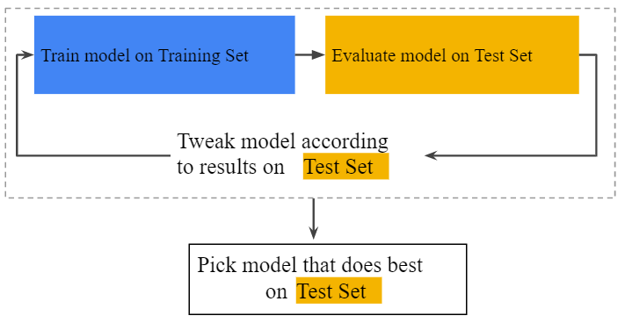
Model Evaluation Technique: Train, Test

Slide 47
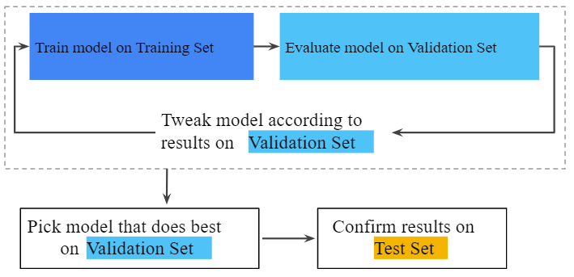
Model Evaluation Technique: Train, Validation, Test

Slide 48
Model Evaluation Technique: Cross-Validation
Split data into k-splits.
Hold out one split as the test data and use the remaining k-1 splits as test data.
Record the performance metric for model
Repeat k times
Less variance in performance across k models results in higher validation of model

Slide 49
Model Evaluation Technique: Parameter Tuning
There are several parameters that can hold different values
We must decide which values are best for our model.
One method is grid search:
Take all combinations of desired parameters and test each one. Select the parameter combination that yields the highest performance value for the selected performance metric.

Slide 50
Performance metrics for classification models

Slide 51
Performance Metrics: Definitions
True Positive: outcome where the model correctly predicts the positive class.
True Negative: outcome where the model correctly predicts the negative class.
False Positive: outcome where the model incorrectly predicts the positive class.
False Negative: outcome where the model incorrectly predicts the negative class.

Slide 52
Performance Metrics: Thresholding
Decision threshold: a value that determines whether an entry is positive or negative
Usual assumption is that the threshold should always be 0.5
Not always the case
Did a student pass the class or not? ( Threshold at 0.7?)

Slide 53
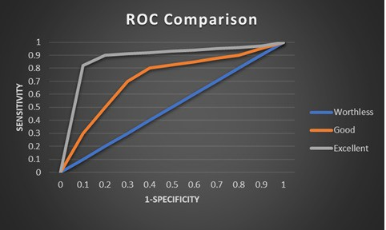
Performance Metric: ROC Curve and AUC
ROC Curve shows performance at all classification thresholds
AUC is the area underneath the ROC Curve
AUC is the probability that a random positive example is ranked higher than a random negative sample
AUC is scale-invariant (ranking not absolute values)

Slide 54
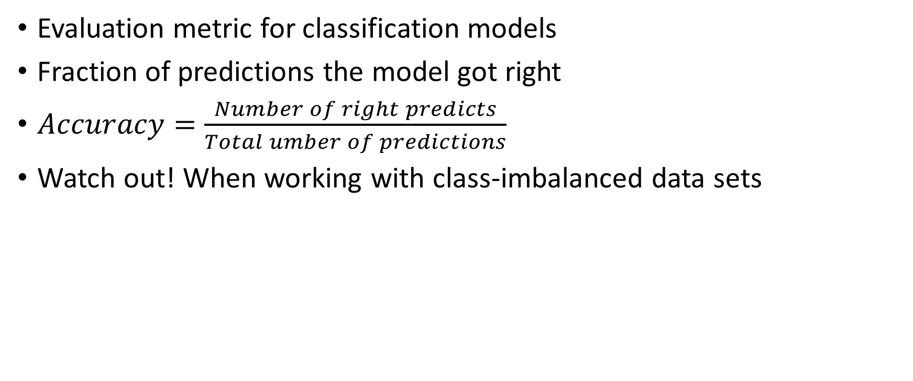
Performance Metrics: Accuracy
Evaluation metric for classification models
Fraction of predictions the model got right
$Accuracy=\frac{Number of right predicts}{Total umber of predictions}$
Watch out! When working with class-imbalanced data sets

Slide 55
Performance Metric: Accuracy
Model to predict cancer in 100 patients
91 Benign, 9 Cancer
Accuracy is 91%
Is this a good model?
Only 1/9 cancer patients were identified.
“Our model predicted 91% of patients correctly.”
True Positive (TP): Truth: Cancer Prediction: Cancer TP: 1 | False Positive (FP): Truth: Benign Prediction: Cancer TP: 1
False Negative (FN): Truth: Cancer Prediction: Benign TP: 8 | True Negative (TN): Truth: Benign Prediction: Benign TP: 90

Slide 56
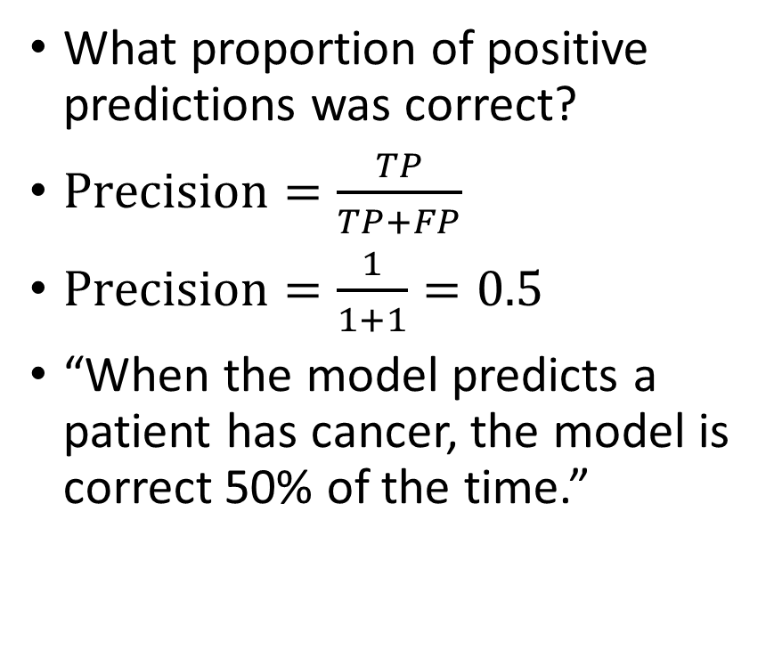
Performance Metric: Precision
What proportion of positive predictions was correct?
$Precision=\frac{TP}{TP+FP}$
$Precision=\frac{1}{1+1}=0.5$
“When the model predicts a patient has cancer, the model is correct 50% of the time.”
True Positive (TP): Truth: Cancer Prediction: Cancer TP: 1 | False Positive (FP): Truth: Benign Prediction: Cancer TP: 1
False Negative (FN): Truth: Cancer Prediction: Benign TP: 8 | True Negative (TN): Truth: Benign Prediction: Benign TP: 90

Slide 57
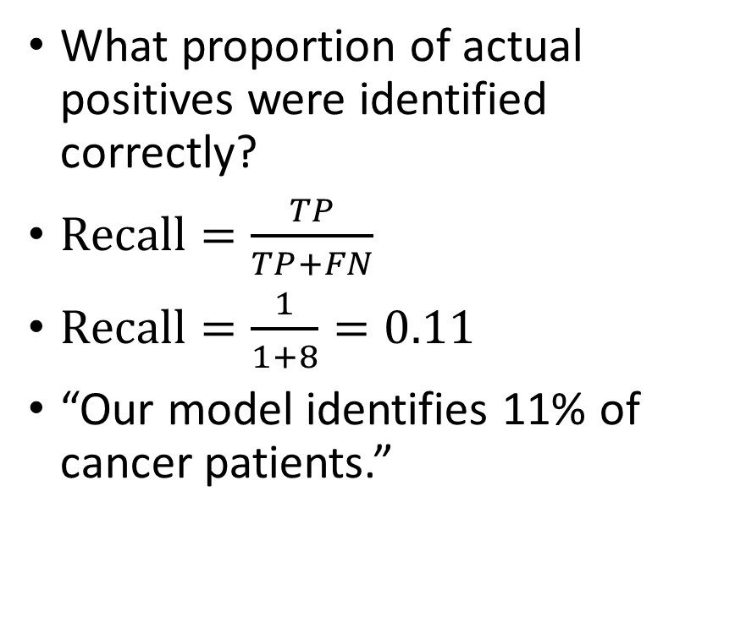
Performance Metric: Recall
What proportion of actual positives were identified correctly?
$Recall=\frac{TP}{TP+FN}$
$Recall=\frac{1}{1+8}=0.11$
“Our model identifies 11% of cancer patients.”
True Positive (TP): Truth: Cancer Prediction: Cancer TP: 1 | False Positive (FP): Truth: Benign Prediction: Cancer TP: 1
False Negative (FN): Truth: Cancer Prediction: Benign TP: 8 | True Negative (TN): Truth: Benign Prediction: Benign TP: 90

Slide 58
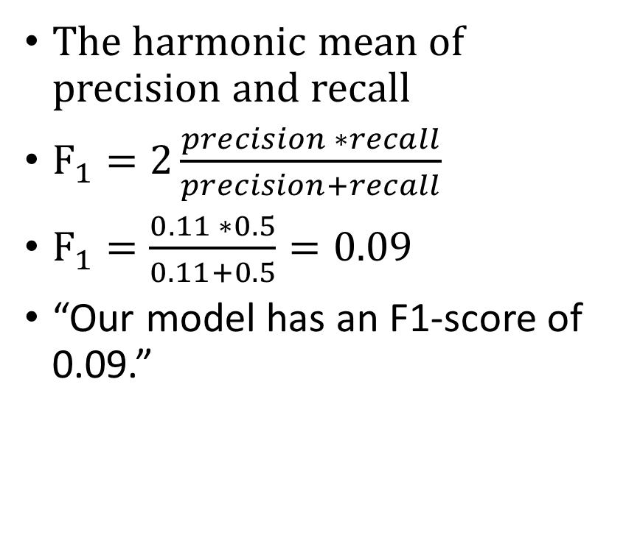
Performance Metric: F1-Score
The harmonic mean of precision and recall
$F_{1}=2\frac{precision ∗recall}{precision+recall}$
$F_{1}=\frac{0.11 ∗0.5}{0.11+0.5}=0.09$
“Our model has an F1-score of 0.09.”
True Positive (TP): Truth: Cancer Prediction: Cancer TP: 1 | False Positive (FP): Truth: Benign Prediction: Cancer TP: 1
False Negative (FN): Truth: Cancer Prediction: Benign TP: 8 | True Negative (TN): Truth: Benign Prediction: Benign TP: 90

Slide 59
Performance metrics for regression models

Slide 60
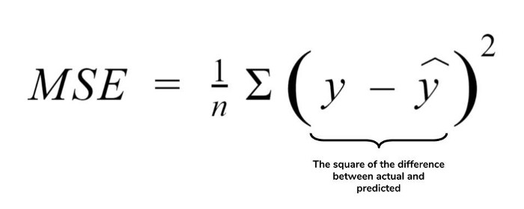
Performance Metric: Mean Squared Error
Mean squared difference between the target and predicted value
Preferred because it is differentiable and can be optimized better
Penalizes even small errors

Slide 61
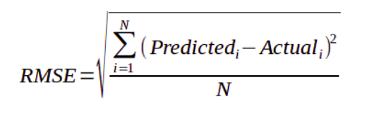
Performance Metric: Root Mean Squared Error
Square root of MSE
High penalty for large errors

Slide 62
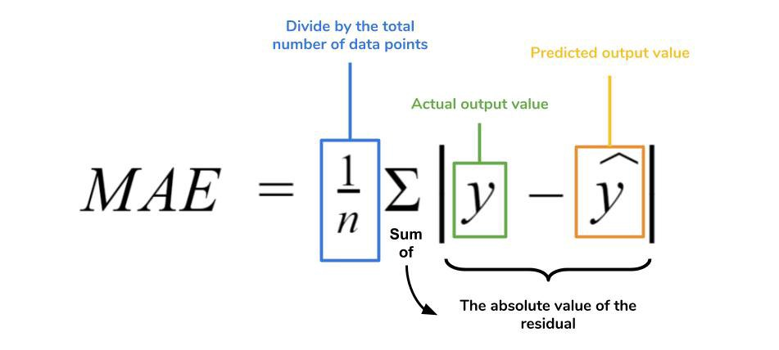
Performance Metric: Mean Absolute Error
Absolute difference between the target and the predicted value
More robust to outliers
Penalty is not as strong as MSE

Slide 63
Questions

Slide 64
LSA6: Understand the concepts associated with Data Analysis. Outcome: At the end of this learning step, students will understand data analysis concepts.

Slide 65
Exploratory Data Analysis (EDA)
Investigate data sets and summarize their main characteristics
Utilize statistics and data visualization methods
Guides how to manipulate the data to best answer the problem you are addressing
Detect outliers or anomalous events before modeling

Slide 66
Why do EDA?
Inform assumptions
Identify obvious patterns, outliers, and variable relationships
Confirms you have the right data you need for the problem
Identify models not correct for the problem

Slide 67
Four types of EDA
Univariate non-graphical
Univariate graphical
Multivariate nongraphical
Multivariate graphical

Slide 68
Univariate non-graphical EDA
Examine one variable
Does not look at correlation or relationships
Describes the data using mean, median, min, max, quartiles, standard deviation.

Slide 69
Univariate Graphical EDA
Examine one variable
Does not look at correlation or relationships
Histogram
Box plot

Slide 70
Multivariate non-graphical EDA
Examine multiple variables
Looks at correlation or relationships
Typically, correlation and covariance.

Slide 71
Multivariate Graphical EDA
Examine multiple variables
Utilizes graphics to display relationships between multiple variables or data sets
Scatter Plot
Multivariate bar plot or histogram
Heat map

Slide 72
LSA7: Understand the concepts associated with Data Visualization. Outcome: At the end of this learning step, students will identify data visualization concepts and create data visualizations.

Slide 73
What are the common elements of a graphic?
Some type of data
Maps data to aspects of the plot
Geometric in nature
Statistical transformation
Coordinate systems
Notes:
A graphic is a visual representation of information.

Slide 74
How are these plots Related?
Scatter Plot
Maps variables to x-axis and y-axis
Uses points to represent each observation
Line Plot
Maps variables to x-axis and y-axis
Uses lines to connect each observation
Histogram
Maps bins to x-axis and frequencies to y-axis
Uses bars to represent bin frequency
Bar Plot
Maps categorical variable to x-axis and counts to y-axis
Uses bars to represent category frequency
Box Plot
Maps 5-number summary ( min, lower-hinge, median, upper-hinge, max) to y-axis
Uses shapes to represent values (box and whiskers)
Notes:
A graphic is a visual representation of information.

Slide 75
How are these plots Related?
Contour Plot
Maps three-dimensional surface to a two-dimensional surface
Maps variables to x-axis and y-axis
Uses contour lines to connect points of same response value
Color bands between contours to represent range of values
Facets
Matrix of two-dimensional graphs partitioned by a third variable
Notes:
A graphic is a visual representation of information.

Slide 76
Python packages for Visualization
Matplotlib
Seaborn
Plotly
Dash

Slide 77
Application for Data Visualization
Exploratory Data Analysis
Present results
Interactive user application

Slide 78
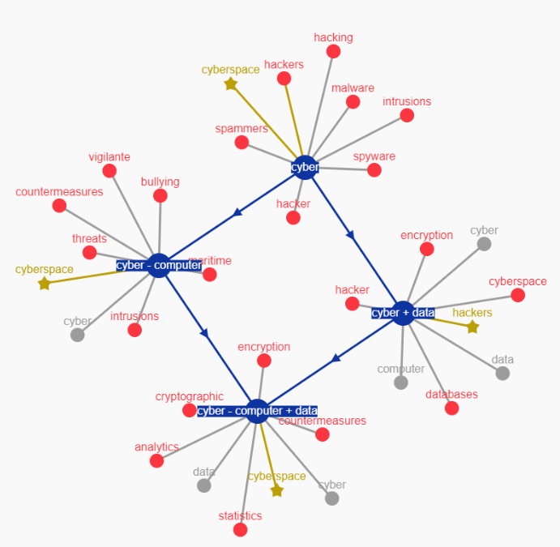
Application for Data Visualization
https://dash-gallery.plotly.host/dash-word-arithmetic/

Slide 79
LSA4: Demonstrate the ability to solve statistical and data processing problems. Outcome: At the end of this learning step, students will solve statistical and data processing problems.

Slide 80
LSA8: Demonstrate the ability use metrics, data analysis and visualization techniques to understand data Outcome: At the end of this learning step, students will use metrics and visualization to analyze data.

